Slide 1
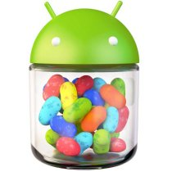
What Is Android?
Google’s software development environment for creating programs for Android-based devices
Based on a cut down version of Java (J2ME)
Has extra libraries to provide
support for mobile-oriented
functionality.

Slide 2
What Does Android Offer?
Development in standard JAVA language
Access to features of mobile phone
Resizeable widgets
Voice Input
Messaging
Phone Calls !

Slide 3
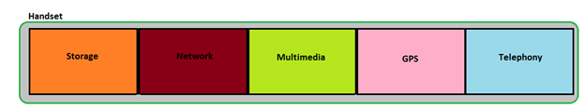
Basic Features of Mobile Handsets
Storage
Network
Multimedia
GPS
Telephony

Slide 4
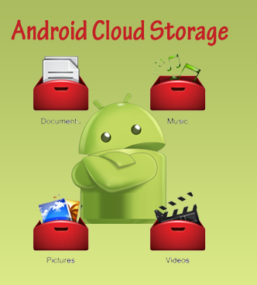
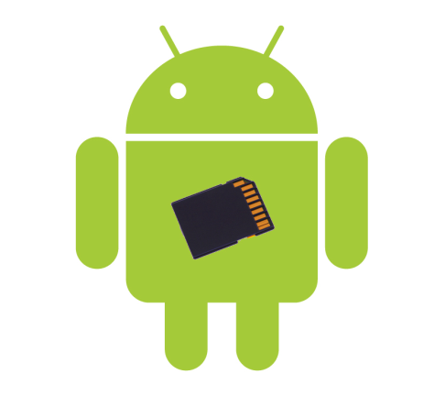
Storage
Android devices allow you to store data associated with your application as well as the application itself. Some applications may require the creation of files and data when it is being executed, these may be stored on the main devices or on external SD cards.

Slide 5
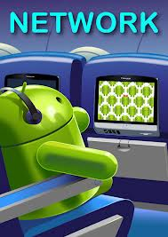
Network
Android devices will generally provide Internet connectivity as standard using one or more on board method of connectivity. As a developer it is possible to provide internet connectivity in your applications at many different levels from raw socket control or through more elaborate web kits.

Slide 6
Multimedia
Android devices have the ability to play and record audio and video. While the specifics may vary from device to device, you can query the device to learn its capabilities and then take advantage of the multimedia capabilities as you see fit, whether that it to play back music, take pictures with the camera, or use the microphone for audio note-taking.

Slide 7
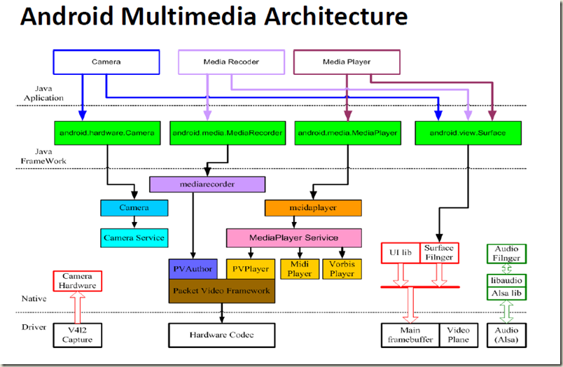

Slide 8
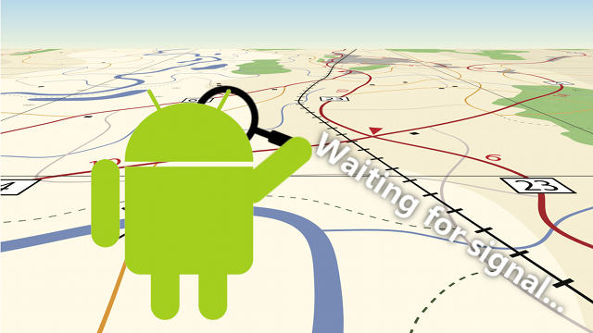
GPS
Android devices will frequently have access to location providers, such as GPS, that can tell your application where the device is and therefore your application use your current location to display your position on a map or maybe to track your position as you move around.

Slide 9
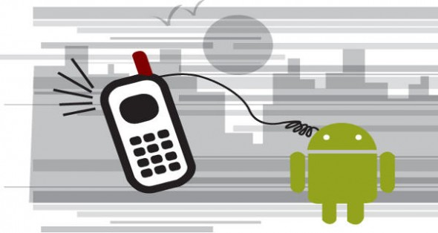
Telephony
It’s easy to forget that Android devices are typically phones, allowing your software to make phone calls, send and receive SMS messages and everything else you would expect to have in a mobile phone.

